Slide 1
Project Phase Report 1 Quadcopter Drone
Open Advanced Course in Embedded Systems Jonas Gartner Sigge Axelsson September 23, 2024

Slide 2
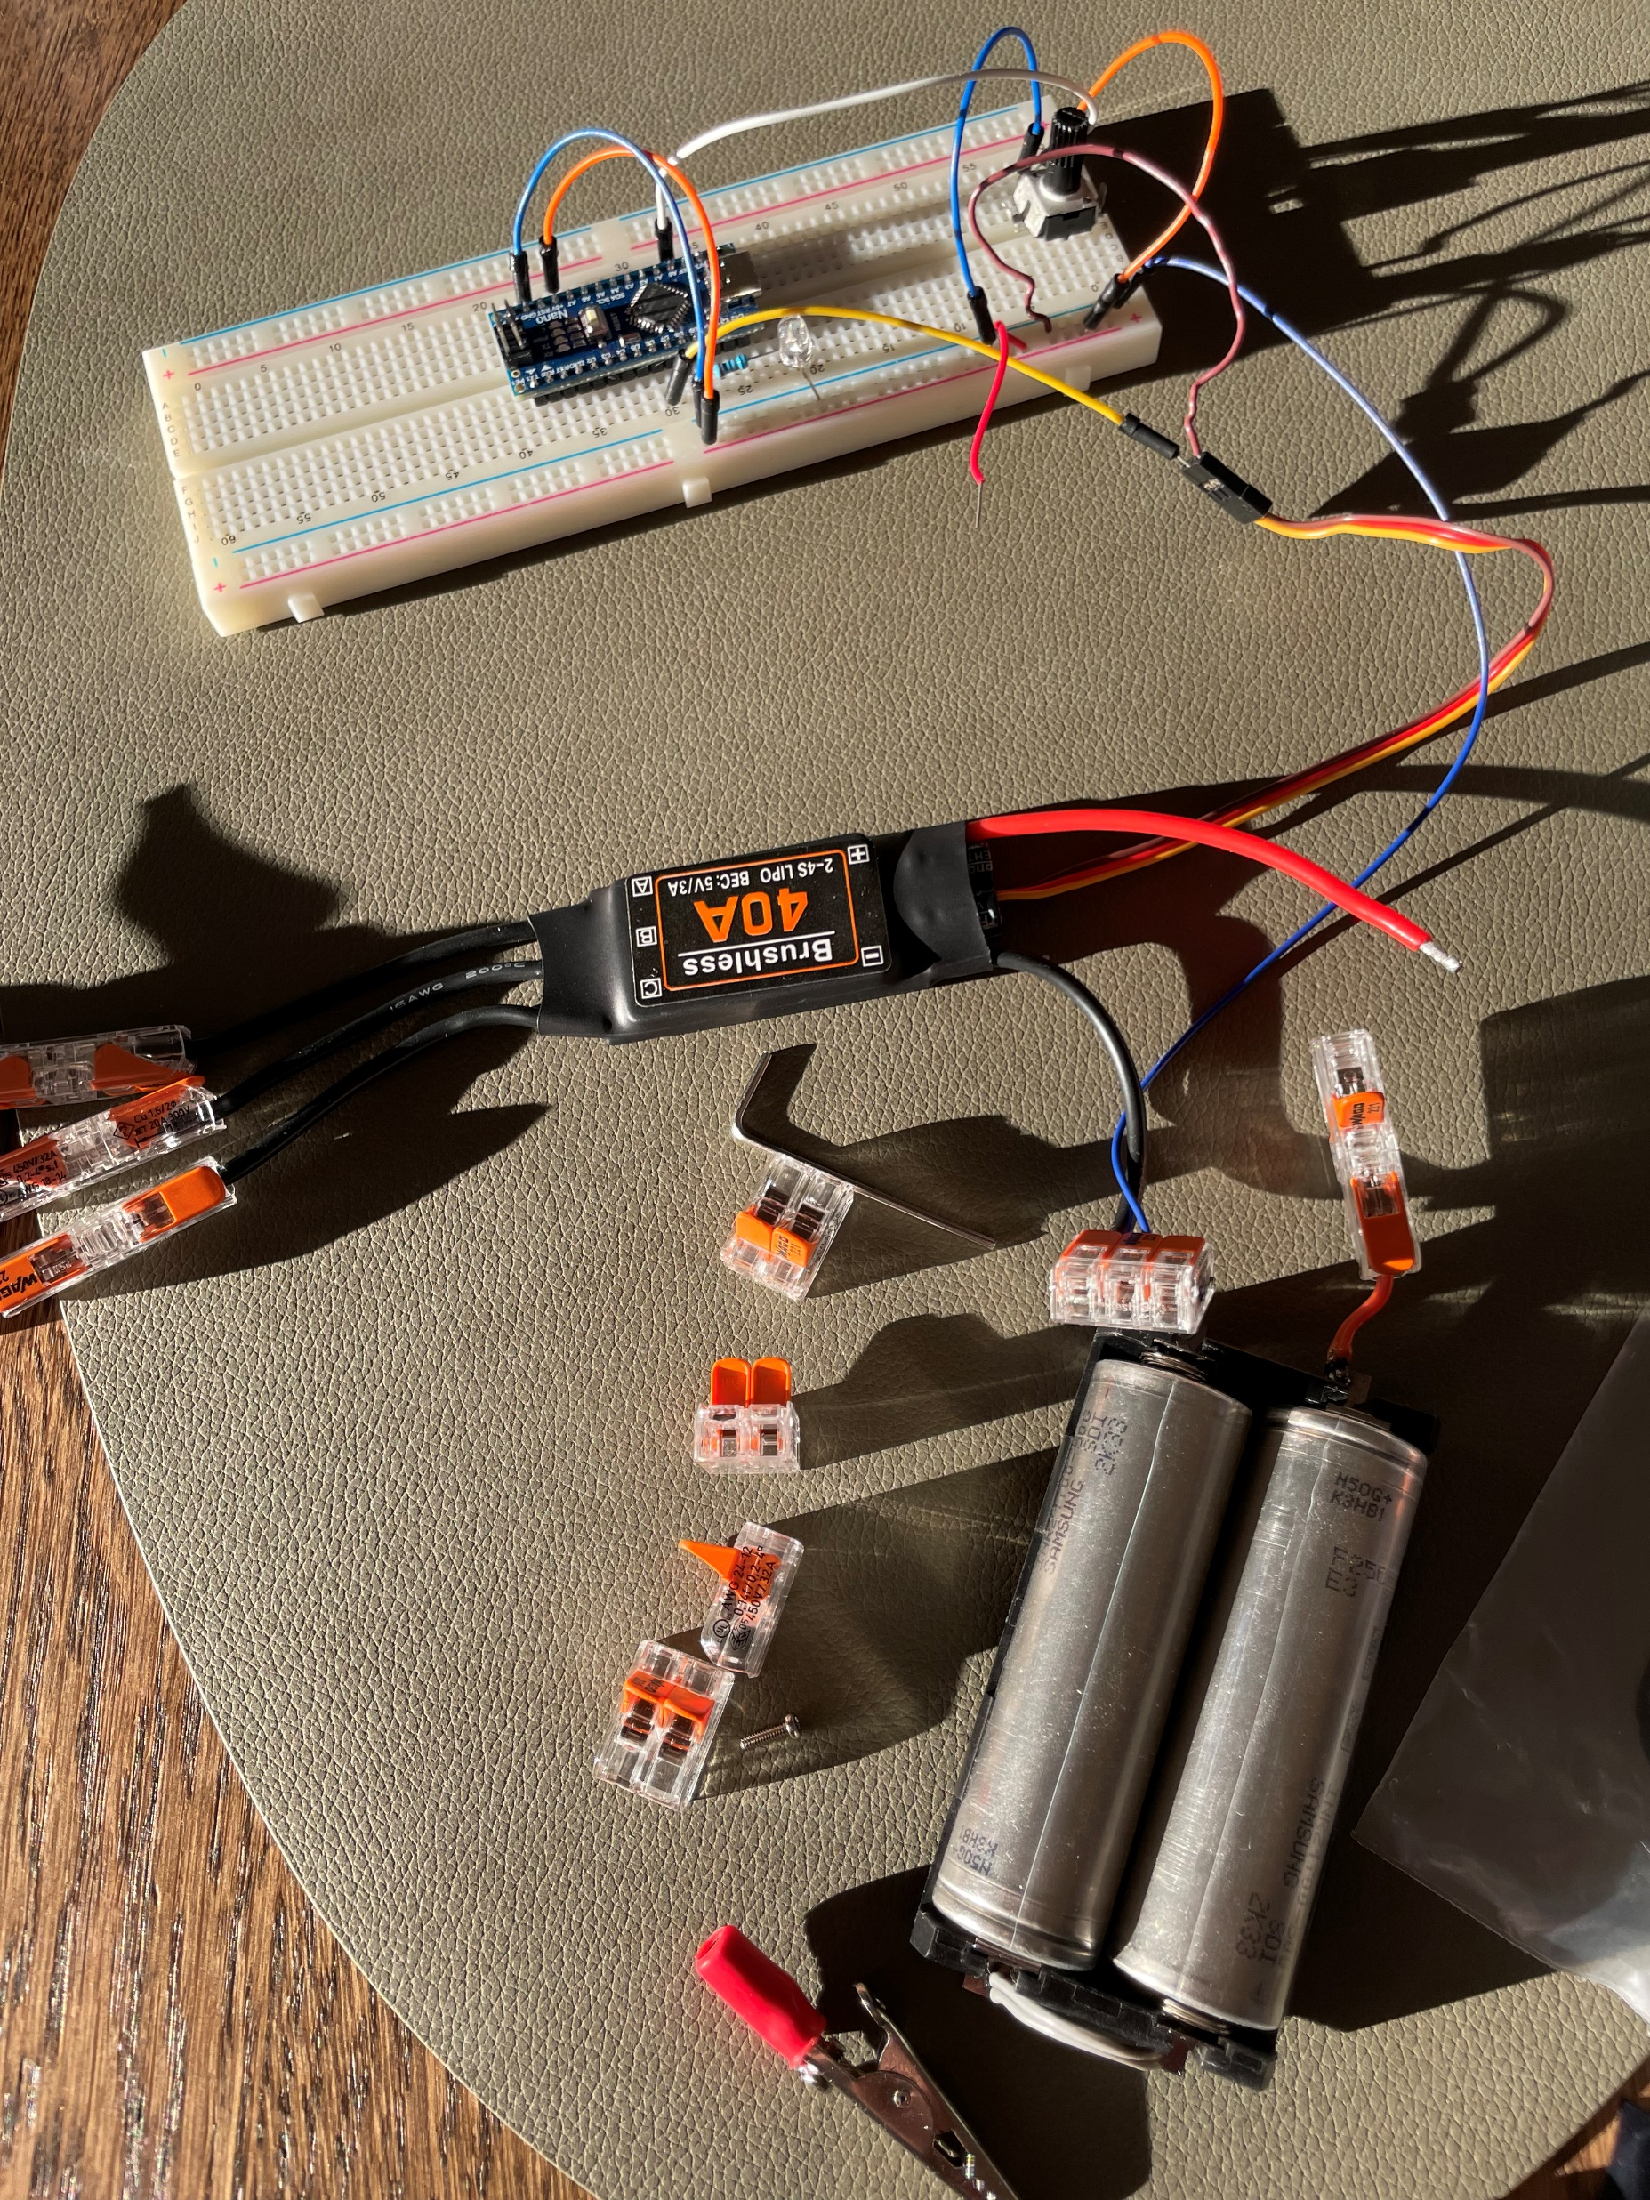
Summary
Conducted research on key components for the drone project over the past two weeks
Selection of motors, electronic speed controllers, batteries, propeller, sensors and MCU
Built a test platform for testing motors och control loops

Slide 3
Brushless DC (BLDC) - Motor
Consist of a permanent magnet rotor and stator windings
Electrical signals switch current in the stator windings to create a rotating magnetic field
Rotor position is determined by sensors (e.g., Hall effect sensors) or sensorless methods to optimize torque
Efficient, reliable, and low-maintenance due to the absence of brushes and mechanical commutators

Slide 4
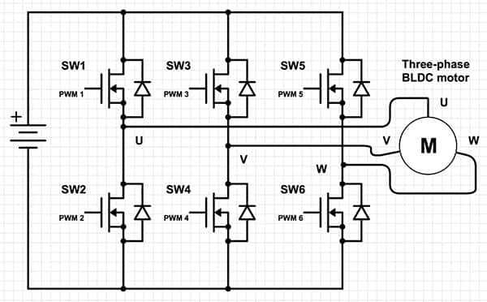
Electronic Speed Controller (ESC)
ESCs regulate motor speed in BLDC motors by switching transistors to create three phase AC.
Motor position is determined by measuring back EMF on the three phases. Logic circuitry then decides which transistor to switch on.

Slide 5
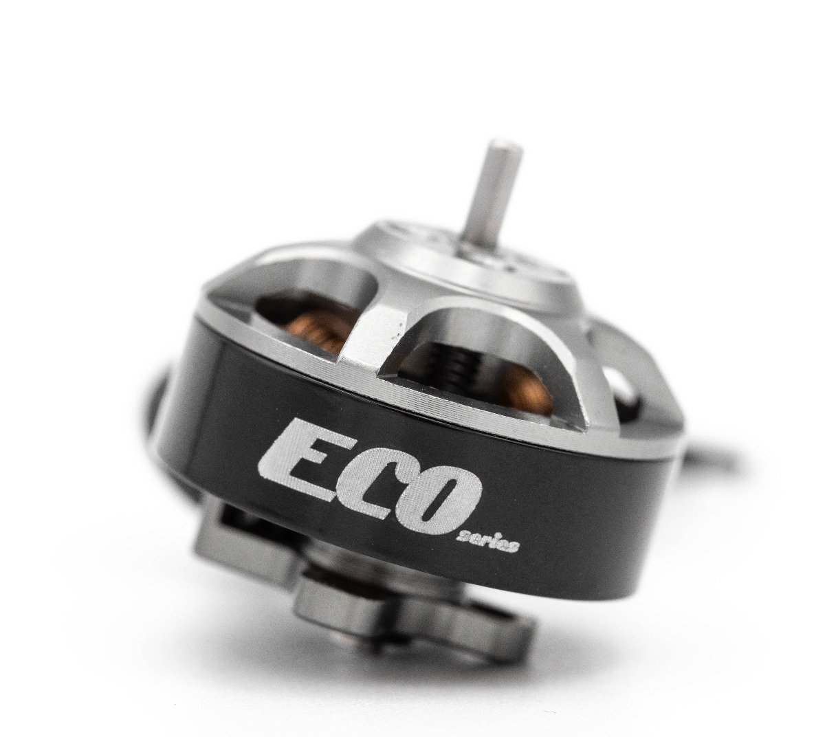
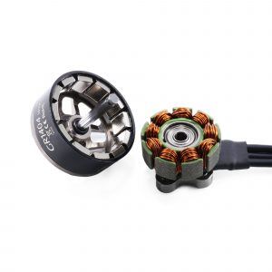
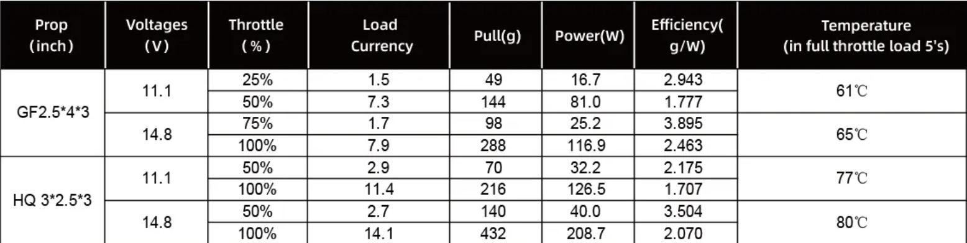
BLDC motor choice
Rotor
Stator diameter
(14 mm)
Stator height (4 mm)
Emax ECO Micro 1404 4800Kv
Approximative lift of 4*200 g = 800 g
Expected max current 4 * 14 A = 56 A
Stator

Slide 6
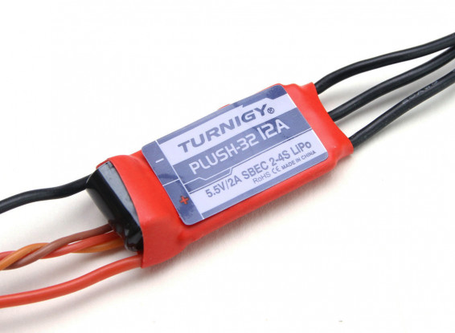
ESC Choise
Selected the Turnigy Plush-32 12A (2-4S) ESC as it meets nominal current and voltage requirements.
Further reaserch on motor max current need to be explored – software to limit max load current. Batteries may also be a limitation.

Slide 7
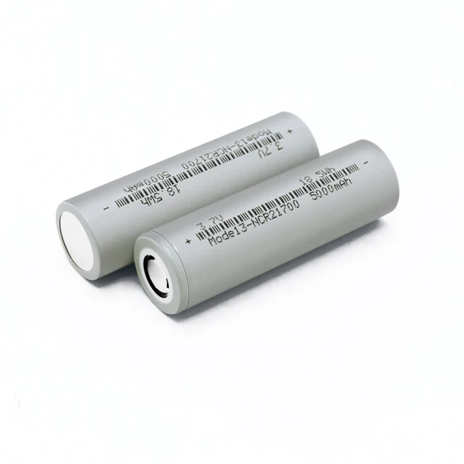
Battery
2 series connected 21700 LiCoO2 cell
Nomial voltage ≈ 3.7V
Capacity ≈ 5000mAh/cell => 18Wh / cell
Internal resistance ≈ 10-30mOhm
Current rating 10-40A depending on cell

Slide 8
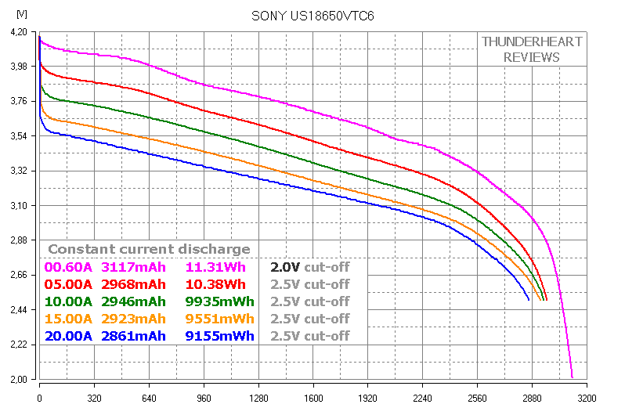
Typical Li Ion discharge curve
Voltage
Charge
100% 0%

Slide 9
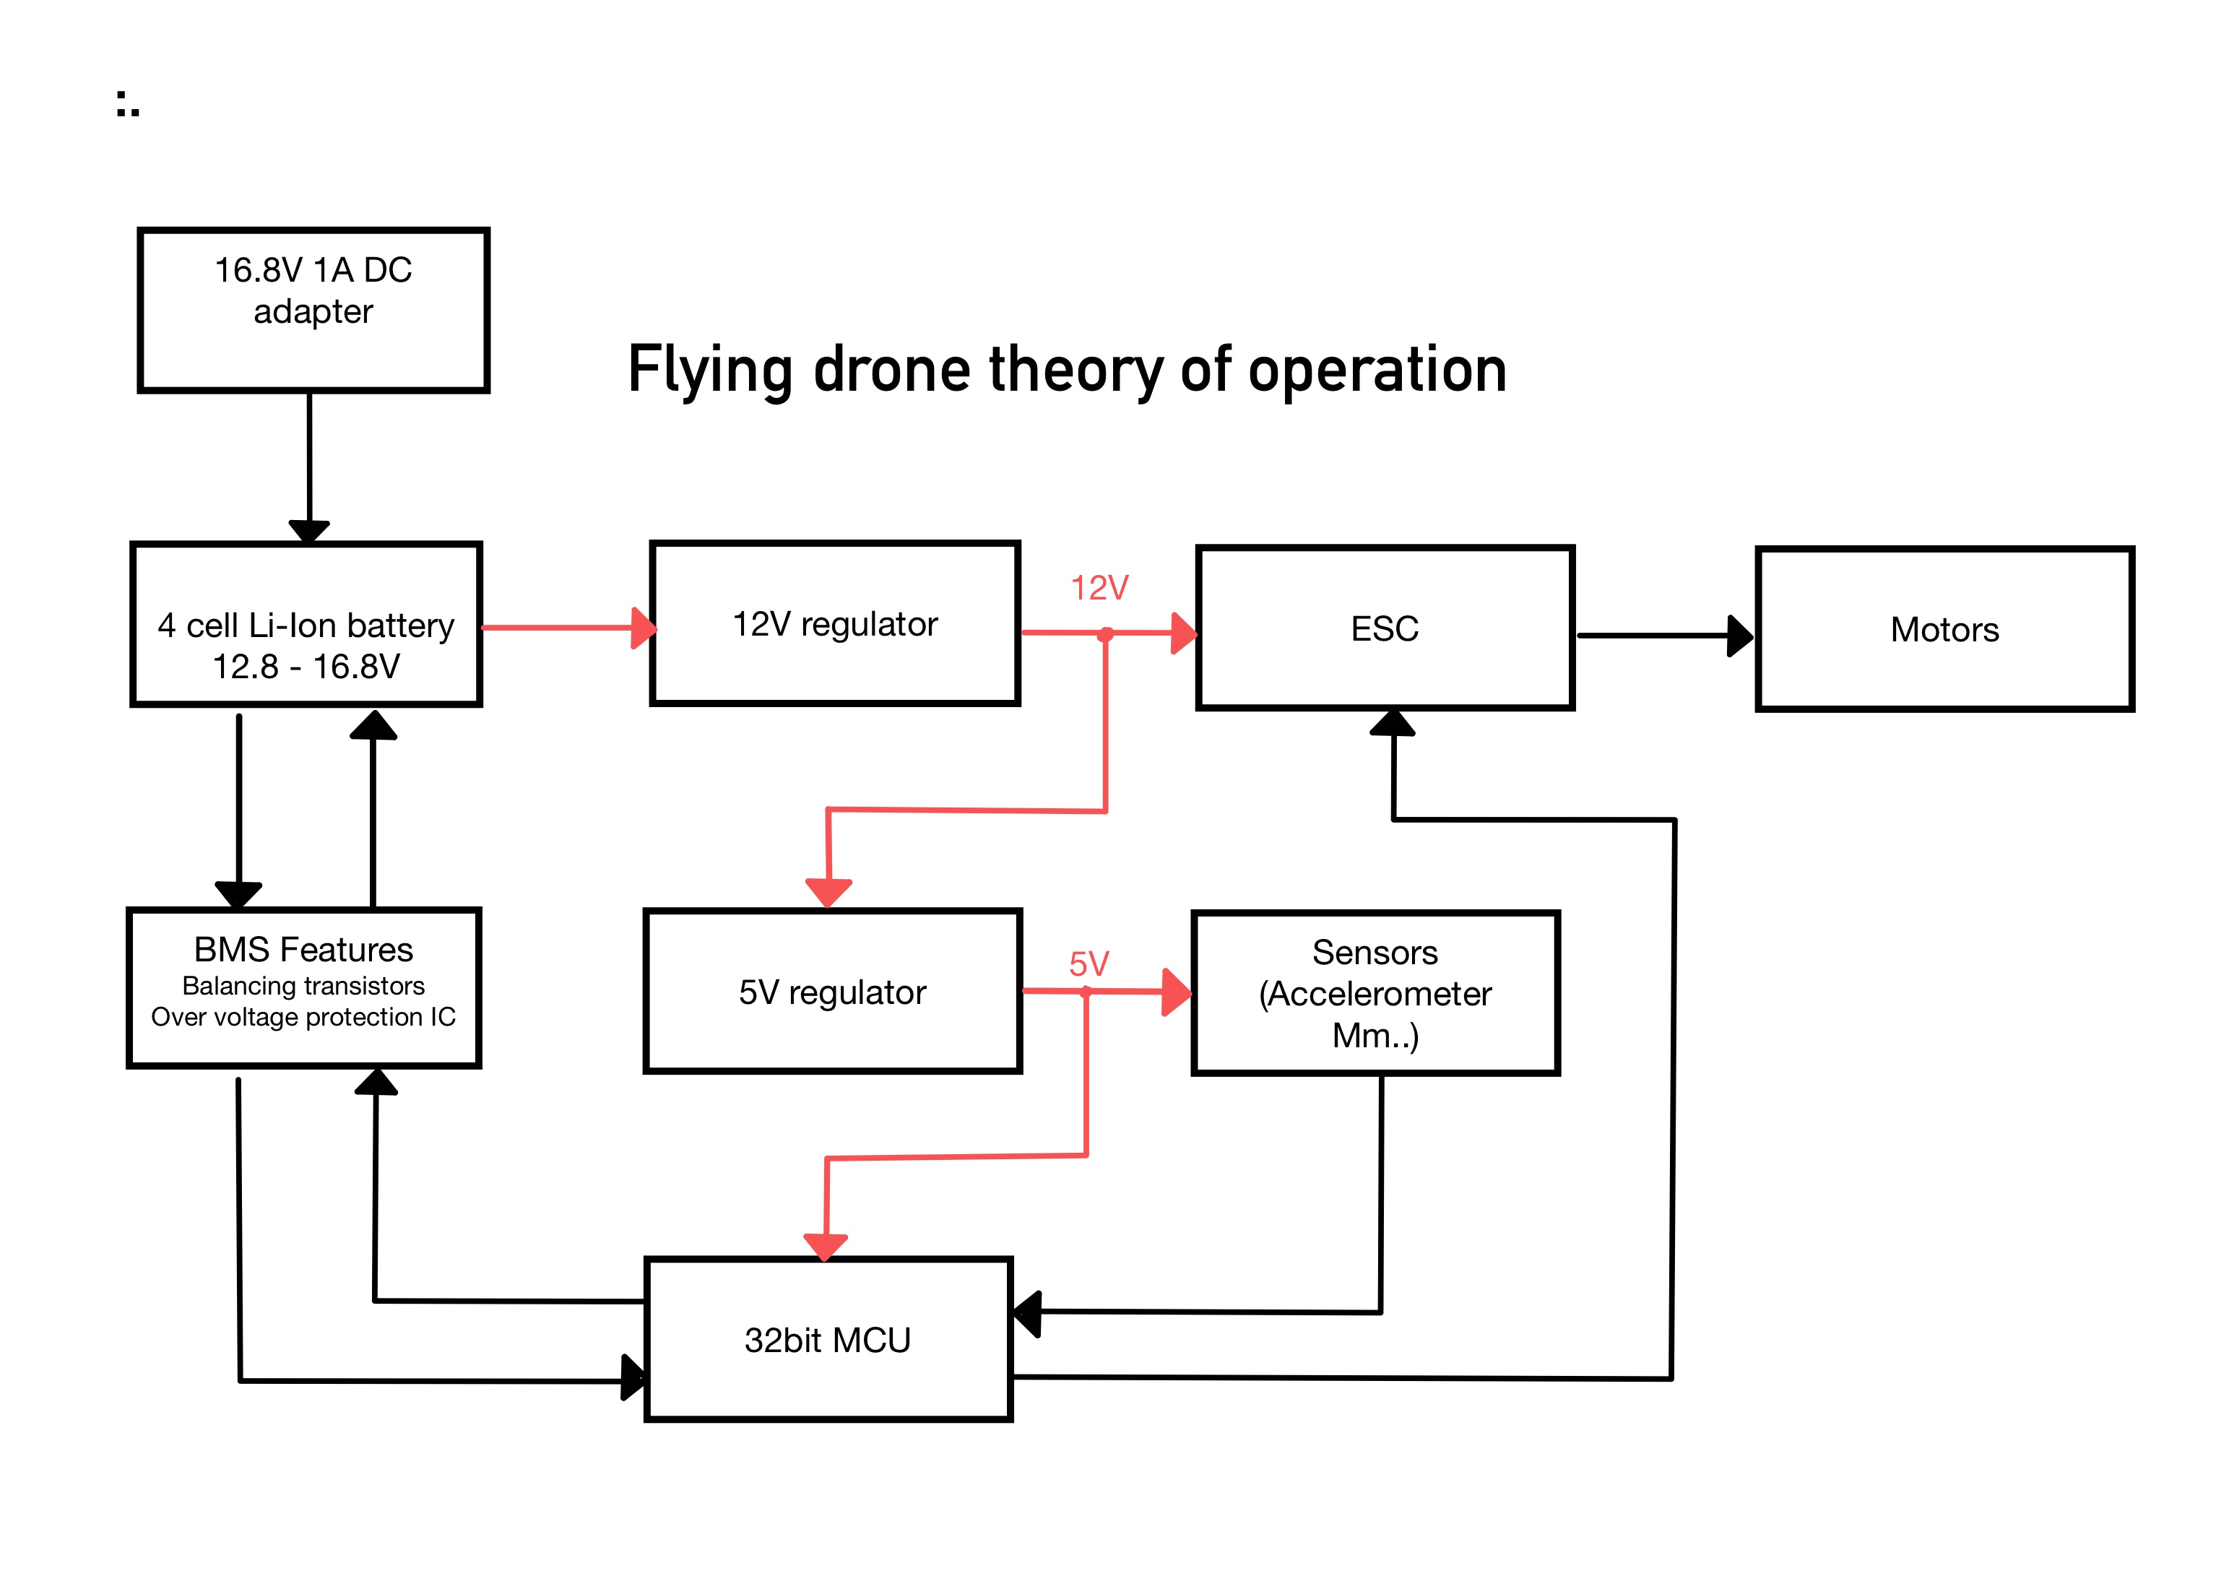

Slide 10
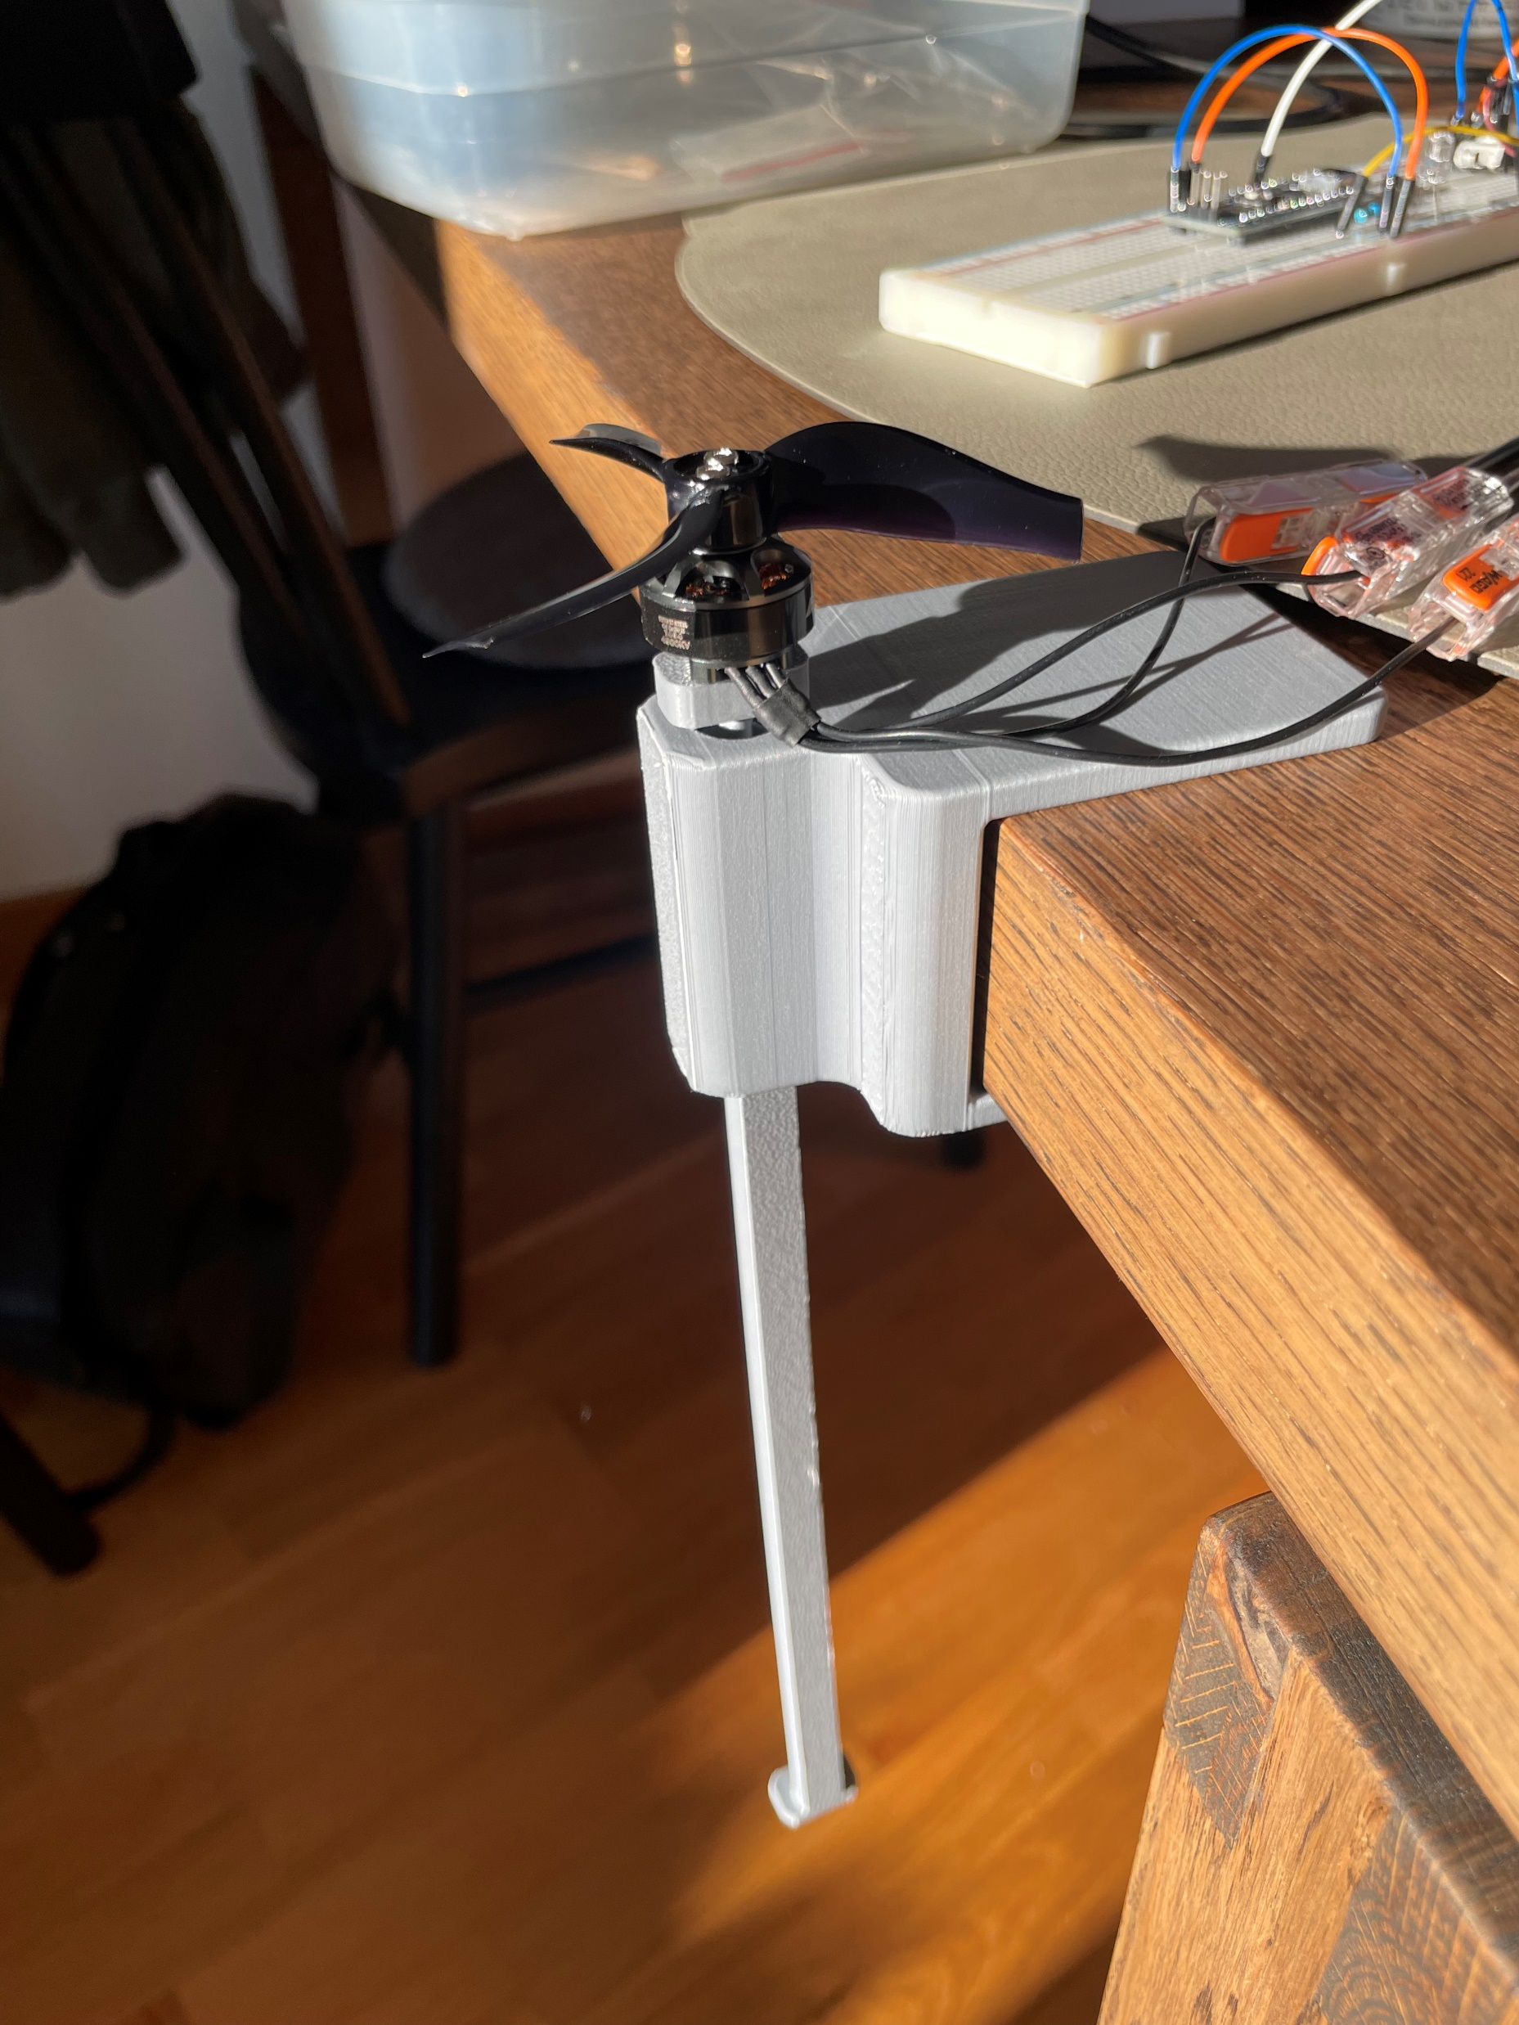
Test Platform
Test motor lift
Measure motor currents
Test control loops for stabilization

Slide 11
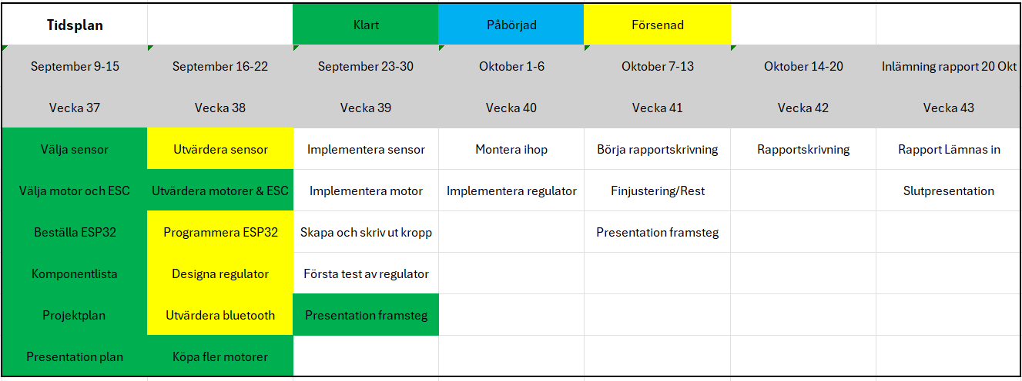
Project status

Slide 12
Questions?

